Slide 1
AMICA: Attention-based Multi-Identifier model for asynchronous intrusion detection on Controller Area networks
Natasha Alkhatib*, Lina Achaji*, Maria Mushtaq, Hadi Ghauch, and Jean-Luc Danger
Notes:
Greetings everyone. Our team consisting of Natasha Alkhatib, Lina Achaji, Maria Mushtaq, Hadi Ghauch, and Jean-Luc Danger both at Stellantis and Telecom Paris is looking forward to present to you how our novel attention based model is able to detect intrusions on the asynchronously transmitted signals by the controller area networks.

Slide 2
Outline
Problematic
AI-based Solution
Anomaly Score and Results
Notes:
Our presentation will be organized as follows:
We will firstly discuss our problematic.
Next, we will go through our AI-based solution for detecting anomalies in transmitted CAN signals
Finally, we will conclude our presentation by providing our research findings

Slide 3
Problematic
Notes:
In our research, we tackle the intrusion detection problem for in-vehicle networks
we have particularly focused on the CAN bus, as it is the most common vehicle bus standard used in modern automobiles.
At present there is a significant emphasis on using rule-based methods to identify known attack scenarios on CAN bus.
While these approaches are effective at detecting various types of intrusions, configuring an IDS using these methods can be time-consuming and requires domain expertise.
Additionally, detecting unknown attacks with these methods is unlikely.

Slide 4
Problematic
Time | ID | Signals of A |  |  |  | Signals of B |  |  | Signals of C |  |  | Signals of D
1.04 | B | - | - | - | - | 54.1 | 0 | 7.4 | - | - | - | -
3.10 | D | - | - | - | - | - | - | - | - | - | - | 31.7
4.97 | A | 12 | 44.1 | 38.2 | 0 | - | - | - | - | - | - | -
7.01 | C | - | - | - | - | - | - | - | 17.9 | 7 | 2 | -
8.99 | B | - | - | - | - | 55.2 | 1 | 7.1 | - | - | - | -
9.75 | A | 13 | 44.2 | 39.7 | 0 | - | - | - | - | - | - | -
Schematic representation of CAN bus data payload
Notes:
Moreover, as seen in this table, generating rules that can accurately capture the complex behavior of multiple signals transmitted via the CAN bus can be challenging.
On the CAN bus, only one message is transmitted at a time, and these messages have different IDs, contain various signals and are transmitted consecutively.
Thus, predicting sophisticated intrusions that affect interdependencies between several CAN signals and transmitted by distinct CAN IDs requires modeling two key dimensions

Slide 5
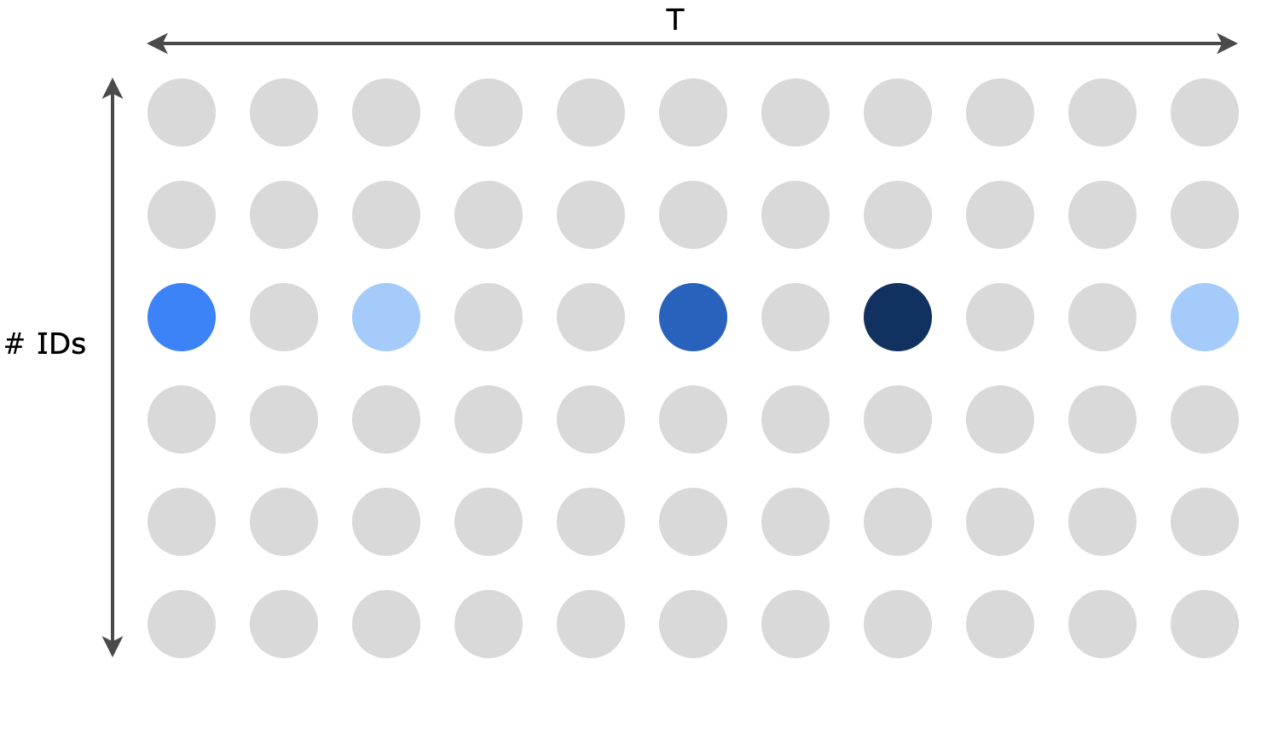
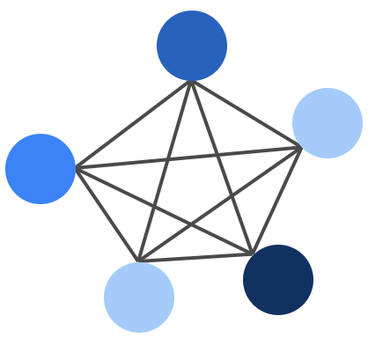
Problematic
Time Dimension
Notes:
The first dimension is the Time dimension: where we model the temporal relationships between signals carried by each ID separately for the CAN message sequence of length T

Slide 6
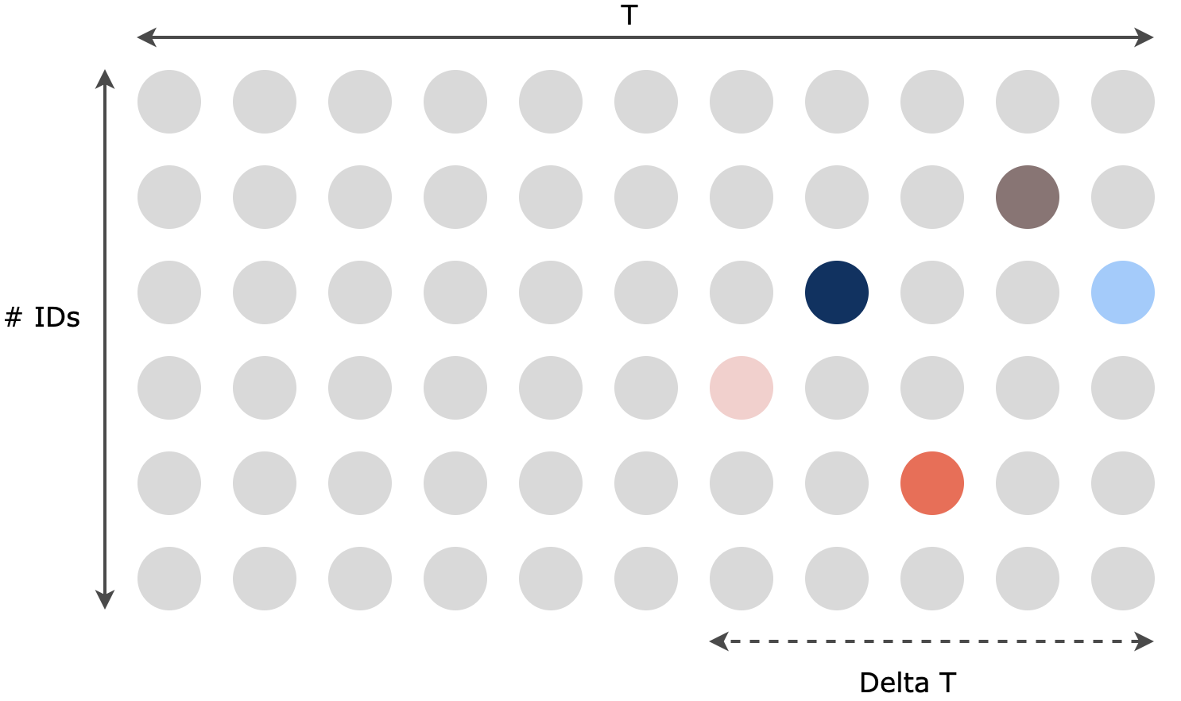
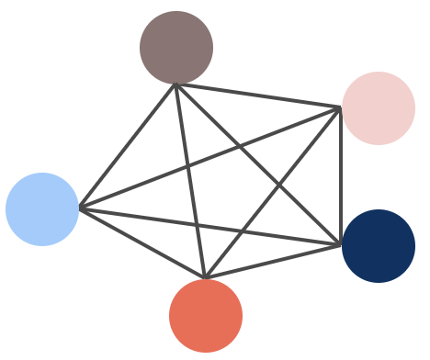
Problematic
Interaction Dimension
Notes:
The second is the Interaction dimension: where we model the interaction between IDs by learning how the state of each ID affects the others.
Since the CAN data is asynchronously transmitted, the interaction graph is calculated during a time interval deltaT

Slide 7
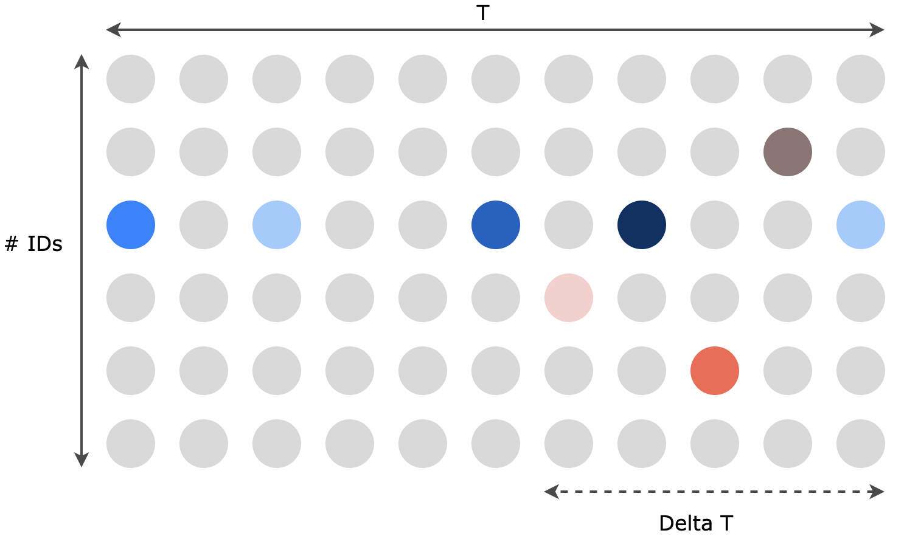
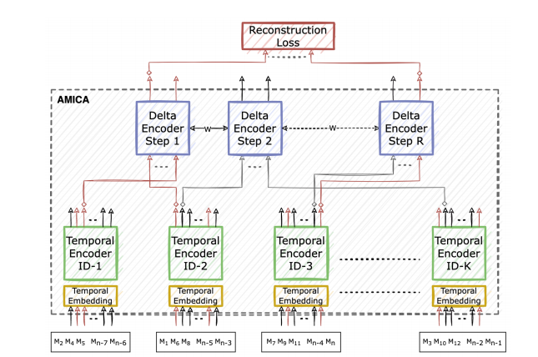
AI based solution
Asynchronous CAN Data
Proposed Model: AMICA
Temporal
Dimension
Interaction
Dimension
Notes:
Thus, to handle the CAN bus data structure in the multi-dimensional signal space, we propose the AMICA IDS
It is a :
self-supervised model
inspired by
the success of BERT model in detecting in-vehicle intrusions
the outstanding performance of Transformers in addressing multi-agent problems

Slide 8
Temporal Encoding
Notes:
The first stage of the model is composed of K temporal modules
Each message transmitted at time t and carried by its respective ID will be fed into its corresponding Temporal module
Each temporal encoder in the temporal module is a bidirectional model that uses the self-attention layer
Since messages are asynchronously transmitted, the temporal contains a global positioning encoding layer
that will encode the relative position of each message with respect to the CAN input.

Slide 9
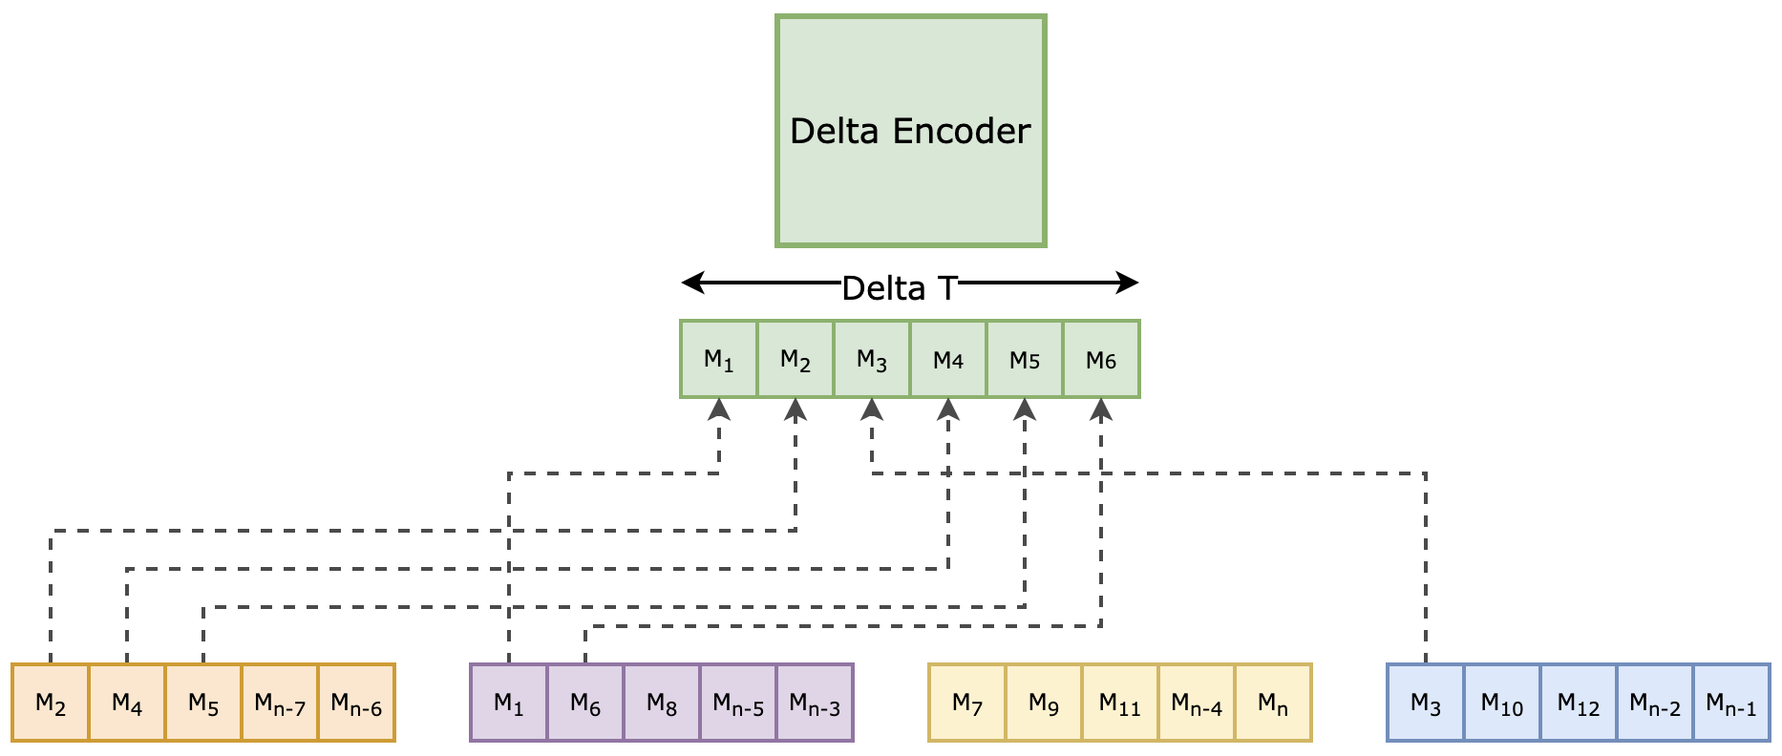
Delta Encoding
Notes:
The encoded signals are then fed into the interaction delta encoding module
This module is responsible for encoding the interdependencies of signals carried by different IDs iteratively for each ∆T in the overall CAN sequence

Slide 10
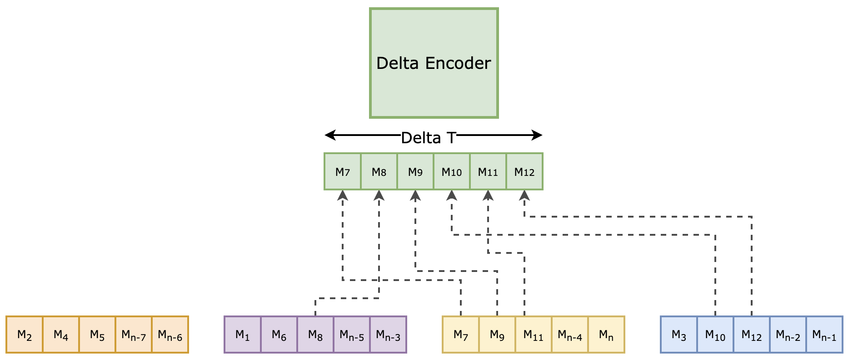
Delta Encoding
Notes:
Contrary to the Tempora lstage that has N separate Temporal Encoders,

Slide 11
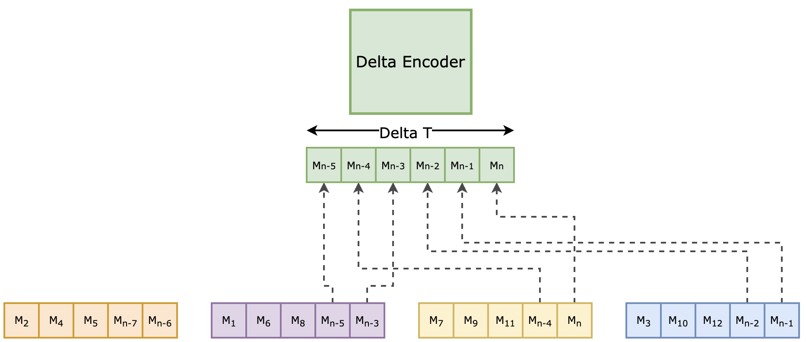
Delta Encoding
Notes:
the Delta encoders will all share the same trainable weights independently of the temporal window to which the set of considered signals belong.

Slide 12
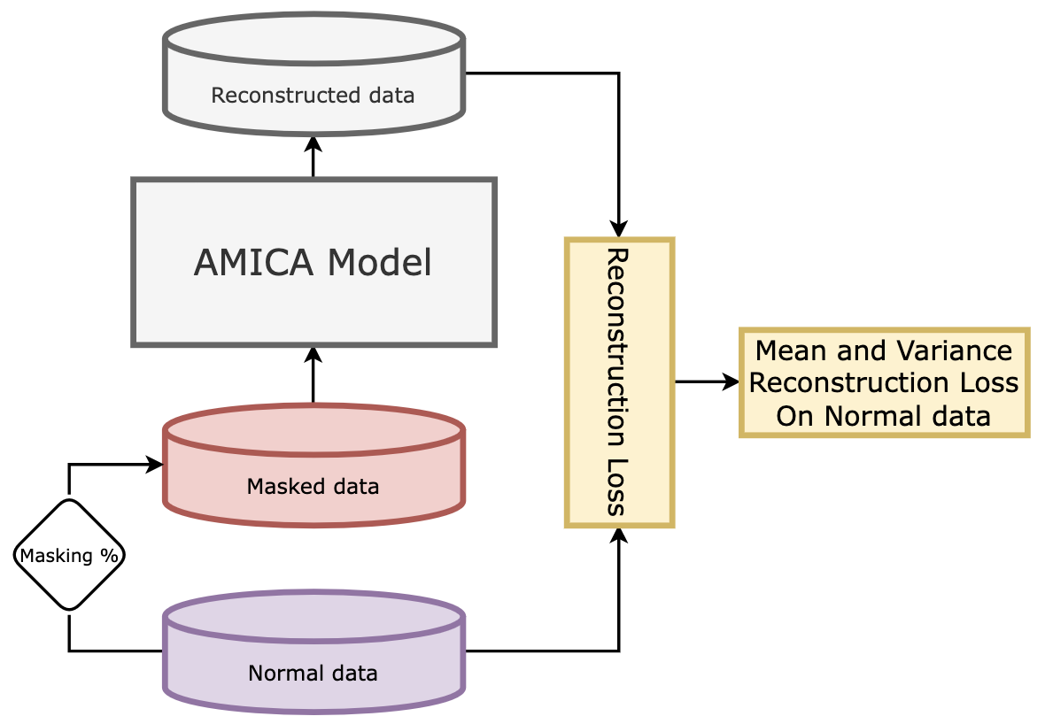
Training workflow
Training workflow
Notes:
We trained the AMICA model using self-supervised learning techniques
We thus mask a percentage of the input sequence at random and forecast these masked signals by leveraging contextual representation
For the AMICA model, we did not embed the input payload values into a discrete vocabular, therefore, the masked signals are replaced by predefined mask-value that is chosen empirically
We consider the mean squared error loss function as the regression-based function for training

Slide 13
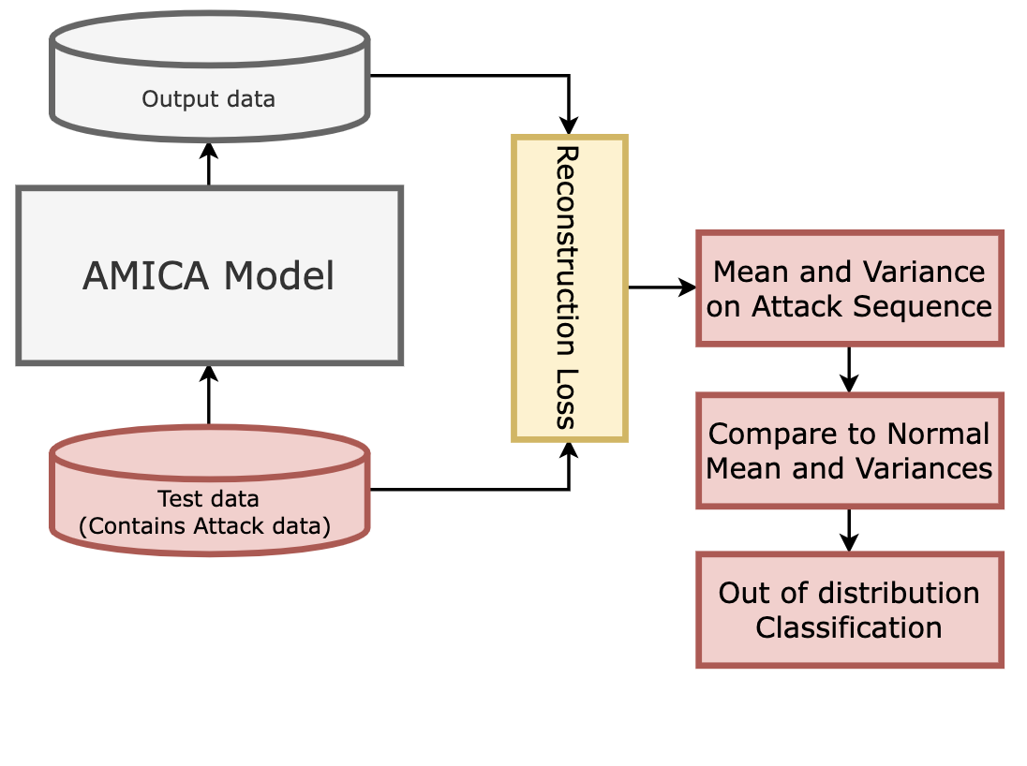
Training and Testing workflow
Training workflow
Testing workflow
Notes:
For testing, we use the quadratic error between the overall masked inputs and their reconstruction to predict whether or not the sequence of CAN IDs is anomalous.
The sequence is considered anomalous if the total sum of the masked signals’ reconstruction error is above a fixed threshold.
This threshold is determined based on normal data as we are considering a self-supervised learning problem.

Slide 14
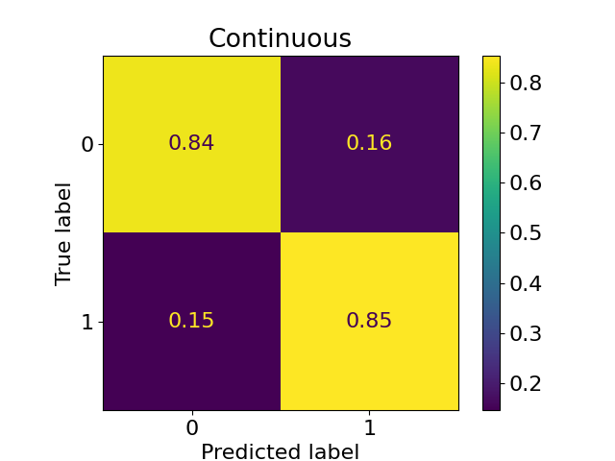
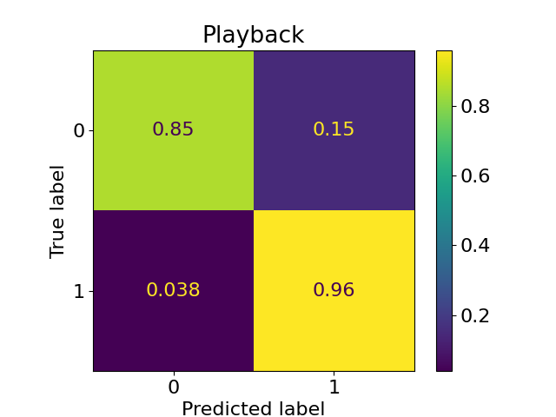
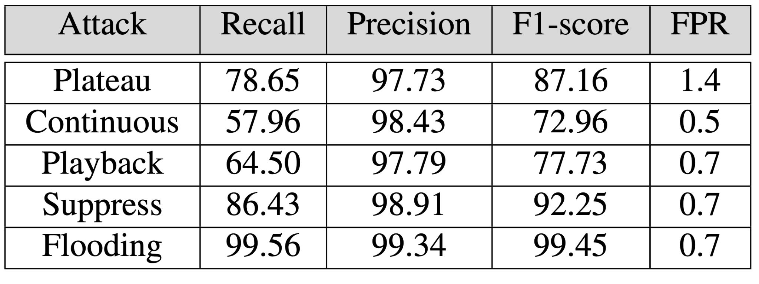
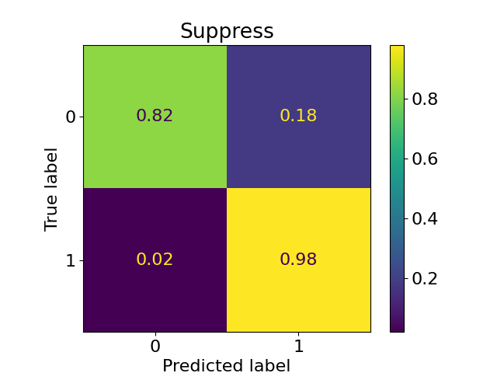
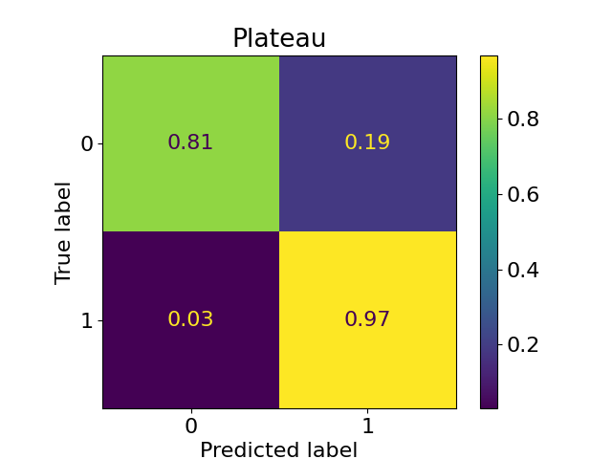
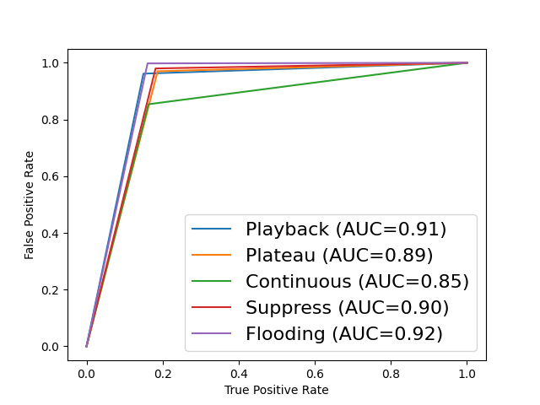
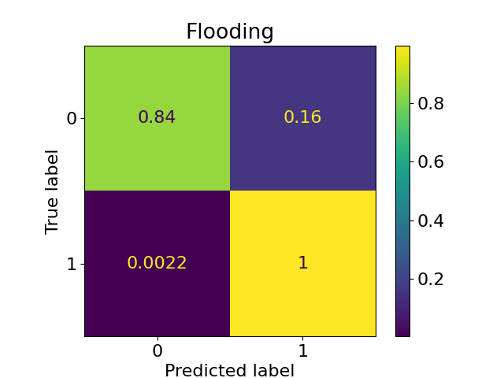
AMICA Results on SynCAN Dataset
Notes:
To evaluate our proposed method, we used the benchmark synthetic CAN dataset called SynCAN
Interestingly, our proposed model AMICA excelled in detecting different types attacks, where the other methods in the literature only fit in frequency-based IDSs or payload-based IDSs.
Our proposed approach is most prominent when detecting Timing Transparent attacks such as suppress and flooding

Slide 15
Conclusion & Future work
AMICA, a novel deep learning based multi-agent system for detecting intrusions on CAN bus.
Detection of different and sophisticated intrusions in long CAN message sequences by :
Modeling contextual information between CAN signals
Devising suitable training process
Future research:
Anomaly threshold for each signal separately
Ablation study on the model architecture with exhaustive hyperparameter tuning
Comparison with state-of-the-art models (ex: CANET, etc.)
Notes:
In conclusion, we proposed a novel deep learning based multi-agent system for detecting intrusions on CAN bus
In future research, we aim to design an enhanced anomaly score strategy that takes each signal separately and to perform better comparisons with the state-of-the-art solutions

Slide 16
Thank you

