Slide 1
Short: Rethinking Secure Pairing in Drone Swarms
Muslum Ozgur Ozmen*, Habiba Farrukh*, Hyungsub Kim, Antonio Bianchi, and Z. Berkay Celik
February 27, 2023
* Co-first authors
Notes:
Hi everyone, I am XXX. I will present our short position paper titled Rethinking secure pairing in drone swarms.
The goal of this paper is to explore the security and design requirements for effective swarm pairing and propose research directions.

Slide 2
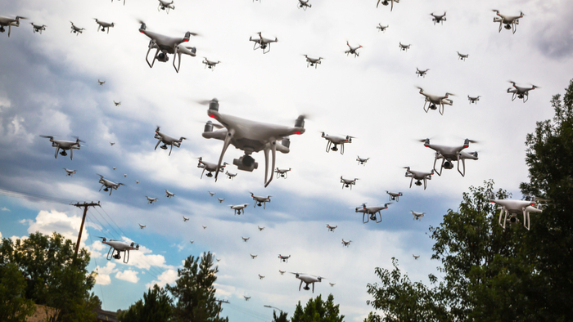
Background & Motivation
Drone swarms enable critical applications
but
You Can Hijack Nearly Any Drone Mid-flight Using This Tiny Gadget
Notes:
Drone swarms are becoming increasingly prevalent for military and rescue missions. Swarms rely on continuous sensing and communication to achieve localization, navigation, and obstacle avoidance for performing these missions.
The critical nature of missions performed by drone swarms makes them an attractive target for adversaries. For example, an adversary could eavesdrop on the swarm's communication and misdirect them during a search-and-rescue operation.

Slide 3
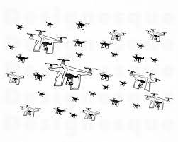
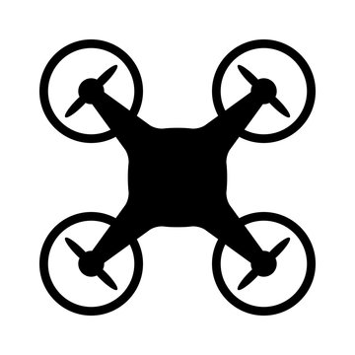
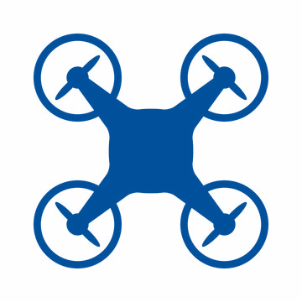
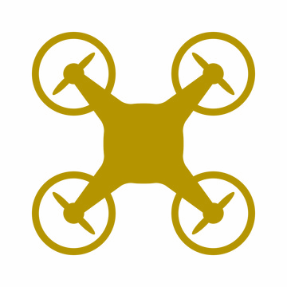
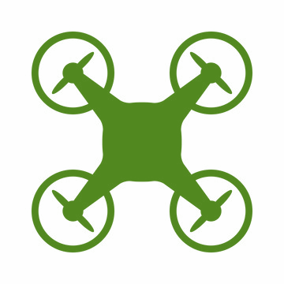
Design Requirements
Swarms need a pairing method to establish secure communication channels that protect the confidentiality and integrity of the messages
Failed Drone
Adversary
R1a: Person-in-the-middle Attacks R1b: Adversarial Drones R1c: Stolen Credential Attacks
R2: Energy Efficiency and Scalability
R3: Drone Addition and Removal
Notes:
To protect swarms against such attacks, they need secure communication channels that protect the confidentiality and integrity of the messages they exchange.
However, designing a pairing system to establish cryptographic keys between member drones has three key challenges.
First, swarms typically operate in environments where no physical protection is enforced. This allows an adversary to pair with the member drones in a swarm or easily capture crashed drones to extract their cryptographic material. So, swarm pairing systems must offer security against traditional network-level attacks such as person-in-the-middle, and also more advanced attacks with adversarial drones and stolen credentials.
Second, an efficient pairing system must consider the computation, memory, and battery consumption constraints of drones in the swarm to ensure longer flight times for drones.
Lastly, to support dynamic drone addition or removal to the swarm, existing drones in the swarm must establish keys with the new ones, and swarm must revoke the keys of the crashed drones.

Slide 4
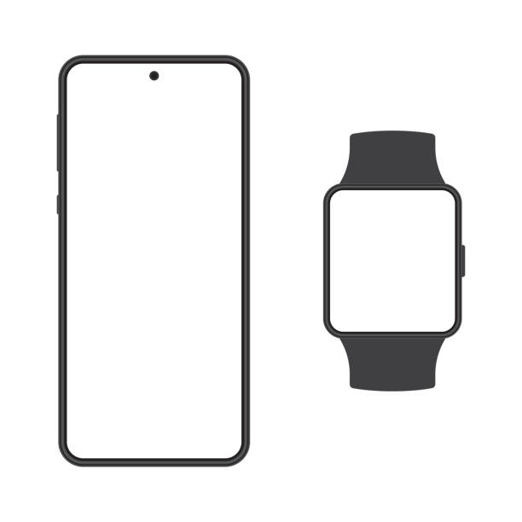
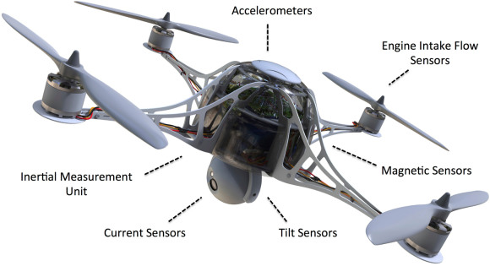
Existing Pairing Solutions
Human-in-the-loop-based
Context-based
Public key cryptography (PKC)-based
****
****
Vulnerable to stolen credentials
Key revocation
Malicious drones can observe the same context
They do not support drone addition
Vulnerable to stolen credentials
Scalability issues
Notes:
Now you might think that device pairing has already been well-studied in smartphones, IoT devices and AR/VR platforms. Unfortunately, applying existing methods directly for pairing drone swarms cannot satisfy the identified design requirements.
First, human-in-the-loop-based approaches require users to actively participate in the pairing process. For instance, to pair your phone with your watch, you are typically required to enter some secret code or perform some gesture. To apply this to drone swarms, the ground control station may physically hard-code a key to each drone before dispatching them. However, the key limitations of this approach are its vulnerability to stolen credential attacks and unsupported key revocation for removed drones.
Second, in context-based pairing schemes, devices leverage their shared context to derive cryptographic keys. For instance, the microphones and the motion sensor recognize the time of a door-close event, which they can use as an evidence of co-presence and establish a key. As drones employ many sensors to continuously sense their physical environment, context-based methods have the potential to enable secure pairing for swarms. During flight, member drones observe similar environmental conditions such as wind gusts, air pressure, and birds flying nearby, which can be used to establish secure keys. However, malicious drones may observe the same context with member drones, and new drones do not have the same context accumulated in the swarm through time.
Lastly, key establishment is well-studied in public key cryptography. For instance, group key establishment schemes have been proposed to derive a single key between multiple drones. However, these schemes are still vulnerable to stolen credential attacks, and they require costly PKC operations which may hurt the energy efficiency of drones.
However, traditional PKC-based key establishment schemes require a public key infrastructure, but it may not be feasible for drone swarms to communicate with certificate authorities. To address this, identity-based and certificateless schemes have been proposed where a trusted third party, such as the ground control station, assigns implicitly certified private and public key pairs to devices.

Slide 5
Existing Pairing Solutions
Unfortunately, existing pairing solutions fail to meet the design requirements of drone swarms
Pairing Solution | R1a | R1b | R1c | R2 | R3
Human-in-the-loop-based | ⚫️ | ⚫️ |  | ⚫️ | ◐
Context-based | ⚫️ |  |  | ⚫️
PKC-based | ⚫️ | ⚫️ |  |  | ◐
Notes:
Our analysis of existing pairing solutions show that they fail to meet the design requirements of drone swarms.
We find that although existing techniques offer security against traditional network attacks such as person-in-the-middle, they fail to offer security against stolen credential attacks and they do not support drone removals.

Slide 6
Research Directions
Protection against stolen credentials
Behavior-based continuous authentication & attestation
Combination of Pairing Solutions
Secure hardware
Identifying crashed drones + maintaining deny lists
Notes:
To address the limitations of existing pairing solutions, we provide future research directions that can meet the needs of drone swarms.
To address stolen credentials, one approach is designing and integrating secure hardware solutions to member drones. This would prevent an adversary from extracting the keys of a captured drone. Such designs must be scalable to a large number of drones and resistant to physical side-channel attacks.
Another approach to address stolen credentials is to identify the crashed drones and maintaining a deny list to prevent such drones from further participating in the communication. One approach to identifying crashed drones could be implementing an energy efficient liveness check mechanism.
Second, to protect context-based pairing systems against malicious drones, behavior-based continuous authentication and attestation techniques could be developed, Such techniques would assess whether drones attempting to join the swarm are benign or malicious. To this aim, these techniques can leverage the physical and network behavior of a drone to fingerprint and authenticate its control software before allowing the drone to join the swarm.
Another natural future research direction is combining different pairing techniques. For instance, designing a context-based pairing scheme and integrating it with human-in-the-loop-based techniques can provide the continuous authentication required to protect against stolen credentials.

Slide 7
Conclusion
In this paper:
We explore the security and design requirements for effective swarm pairing
We show existing pairing techniques are not sufficient to meet the needs of drone swarms
We propose research directions for designing swarm pairing methods that satisfy the unique needs of swarms
These research endeavors are of utmost importance for secure and trustworthy drone swarms
Notes:
In this paper, we outline an adversarial model and the ideal design requirements for secure pairing in drone swarms. We then survey existing pairing schemes and show that they cannot meet the needs of swarms. We provide future research directions that can offer secure, energy-efficient, and scalable pairing.
These research endeavors are of utmost importance for secure and trustworthy drone swarms

Slide 8
Thank you! Questions?
mozmen@purdue.edu & hfarrukh@purdue.edu
Notes:
Thank you!

Slide 10
Backup

